Slide 1





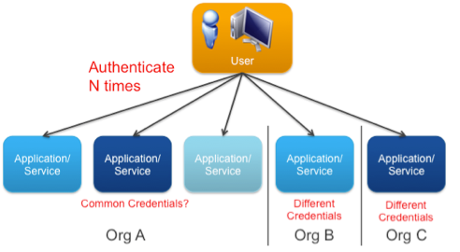
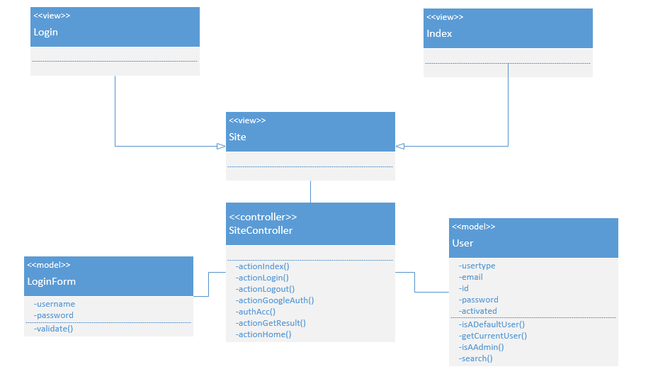




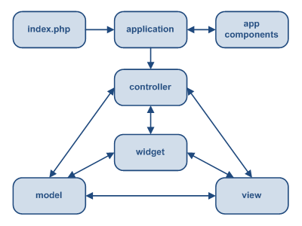
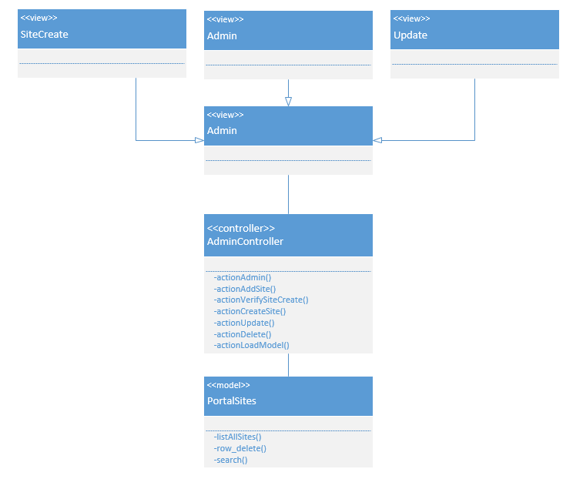

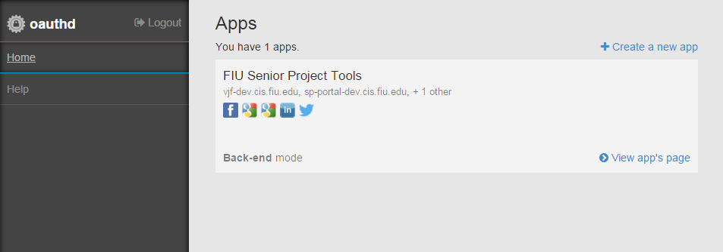
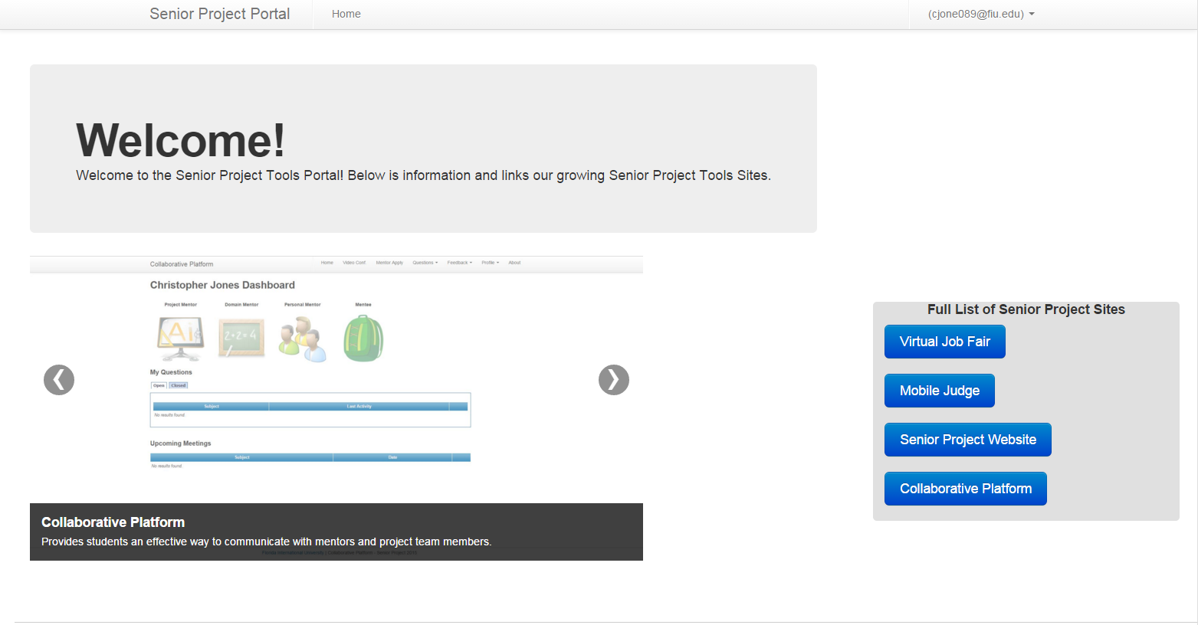
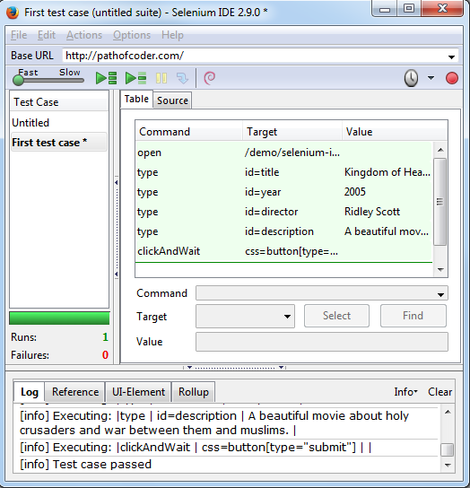
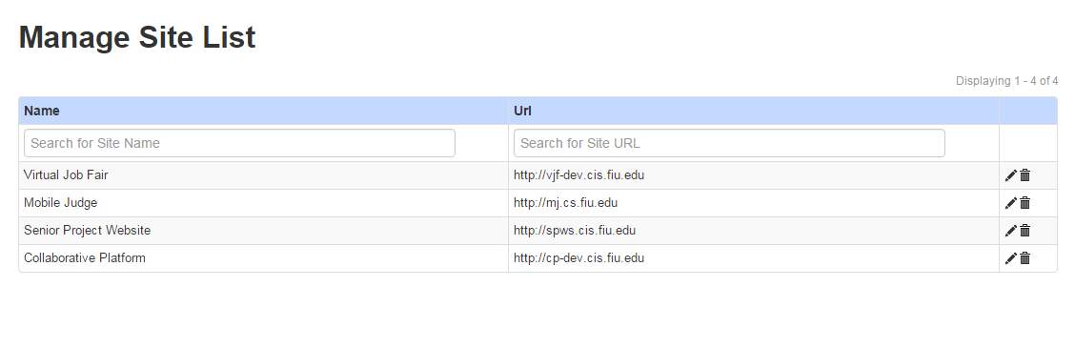

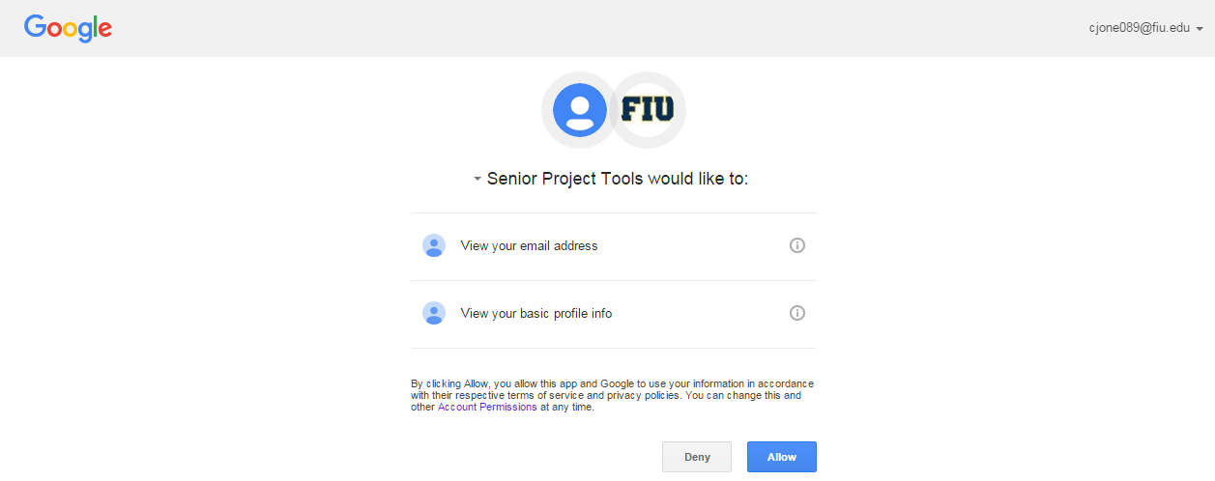
School of Computing & Information Sciences
Senior Project, Fall 2015
Senior Project Portal 1.0
Student: Christopher Jones, Florida International University
Mentor: Dr. Masoud Sadjadi, Florida International University
Instructor: Masoud Sadjadi, Florida International University
Problem
Current System
Requirements
Currently the four web applications used for Senior Project (Virtual Job Fair, Senior Project Website, Collaborative Platform, Mobile Judge) are all independent software systems with no method for accessing them from the same location.
A Senior Project Portal site is a solution which would provide FIU Senior Project students and professors with a means to access the four Senior Project web applications from one centralized location.
The system should also have single sign-on capability, a property which allows the user to log in with a single ID and password and gain access to the other Senior Project sites without using different credentials for each site.
Virtual Job Fair, Senior Project Website, Collaborative Platform and Mobile Judge each presently have their own independent authentication mechanisms and must be accessed by navigating to each site separately.
To improve both the user experience and the efficiency of the system, a portal was the best method for centralizing access to Senior Project sites.
Implement login system utilizing Google authentication for FIU Panther Mail users through OAuth Daemon
Create a system administrator dashboard where Senior Project sites can be edited, added or deleted from the portal
Implement single sign-on
System Design
Object Design
Implementation
Login
Main technologies used:
Senior Project Portal was developed using the Yii Framework, a Model-view-controller PHP web application framework.
Using OAuth Daemon, it was possible to setup a stand-alone web Background API server which was used for my Google authentication feature. It completely abstracted away from the complexity of OAuth 2.0 integration and can be used to seamlessly add additional API providers in future releases.
Admin Dashboard
Verification
Screenshots
The system was tested through the use of automatic regression tests on Selenium IDE. Test cases were created for both Student features and Admin features, with the purpose of identifying defects in the system and fixing them during development.
Summary
The intention of this release was to bring the Senior Project sites closer together and simplify access for students and professors in future semesters. As implemented, the stand-alone system seamlessly logs users into the specific Senior Project which they select and also provides additional administrator options for controlling the site content.
During this project, I gained several beneficial skills relating to web development and the software engineering process. After completion of this project, I gained working knowledge of PHP, OAuth and Yii while improving my knowledge of HTML, CSS, jQuery and MVC.
Acknowledgement
The material presented in this poster is based upon the work supported by Dr. Masoud Sadjadi. I am thankful to the help that I received from my group members, Ricardo Dominguez and Frank Hernandez. .

